Slide 1
Final Project presentation
Martin Noboa
November 19th, 2021

Slide 2
Introduction

Slide 3
Why this project?
What is the project?
Adventure text-based game developed in Prolog called “Forgotten”.
What is a text-based game?
A text-based game is a form of electronic gaming where the user interacts with a text interface giving commands in ASCII characters.
History of text-based games.
Began in the 1970s with the creation of “Colossal Cave Adventure”.
Limited by the technology of the time.

Slide 4
Game

Slide 5
What is the game about?
As I mentioned previously, the game’s name is Forgotten.
The game is set in an abandoned castle and its nearby areas, such as a forest and a cave.
Is a maze like adventure game, where you must collect certain items to complete it.
You beat the game once you get the recorder.

Slide 6
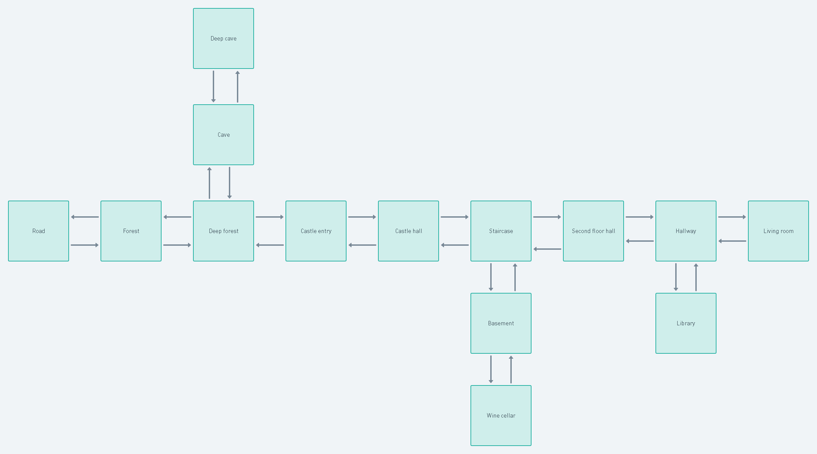

Slide 7
SOLUTION

Slide 8
How was the solution built.
Knowledge base.
Facts. All the statements declared for the program to consider true.
Rules. Predicate expression that uses the logical expression (:-). The rules work with the facts to create logical assertions and thus create the logic of the game.
Dynamic facts.
Dynamic facts or predicates are the basis of this project. Facts are declared as static automatically, but they can be declared as dynamic.
If facts are declared as dynamic, we can change their values while the program is running.
This is the most important part of the project; without dynamic facts the program wouldn’t work.

Slide 9
RESULTS

Slide 10

Documentation

Slide 11


Slide 12
conclusions

